Slide 1

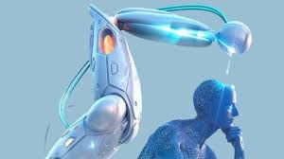
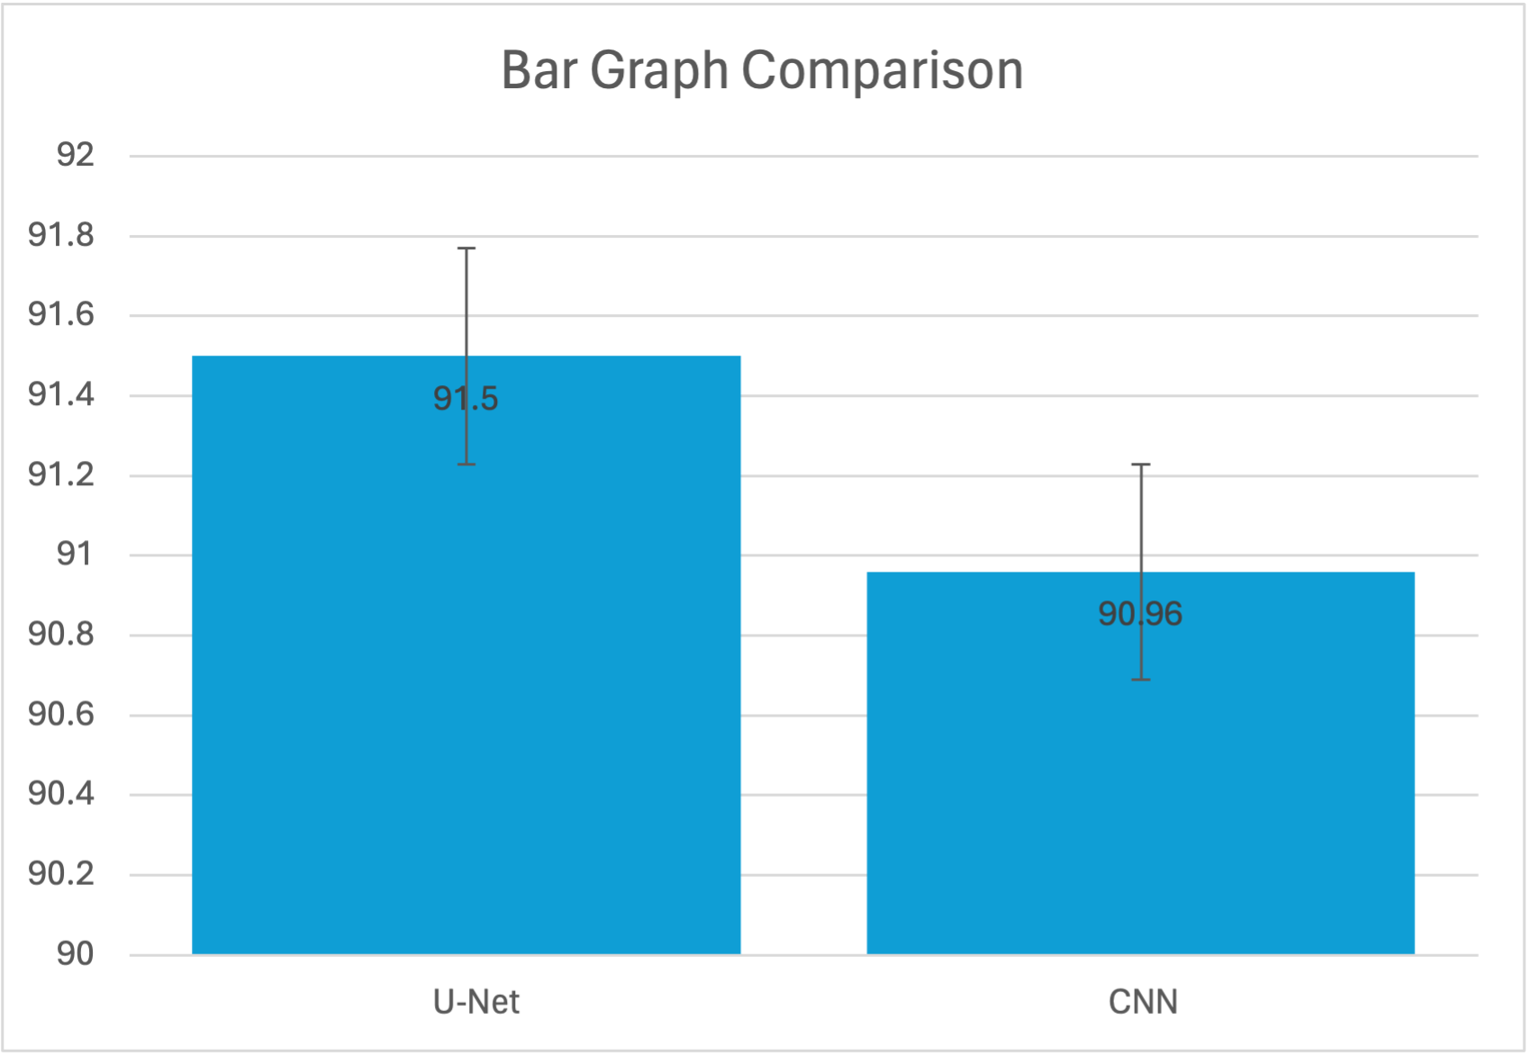
Name: Mr. Sunil Shuraj N Register Number: 192224019
Guided by Dr. Sivagami S
Ms. Poorani.S
Guided by Dr. Mary Valantina. G
Educational Impact of Advanced Diagnostics: A Study on Brain Tumor
Detection using CNN and U-Net
INTRODUCTION
A brain tumor is an abnormal growth of cells in the brain, which can interfere with normal brain function and potentially lead to serious health issues. Treatment options vary depending on the type, size, and location of the tumor.
Machine learning (ML) enables software applications to improve accuracy in outcome prediction without direct programming. ML algorithms analyze historical data to forecast new output values.
This study aims to compare the effectiveness of CNN and U-Net in Detection of Brain Tumor , with a focus on improving detection accuracy.
The performance of CNN networks and U-net models for brain tumor detection is assessed solely based on accuracy as the evaluation metric.
Our aim is to contribute to the advancement of predictive modeling techniques for brain tumor detection and improve decision-making processes in medical diagnostics and treatment planning.
BI Techniques
Brain Tumor detection with advanced technology for well-being
MATERIALS AND METHODS
User
Brain Tumor data
Data visualization
And
Modelling
Multi_Layer
percepton
Preprocessing
Decision makers
Classified output
Brain Tumor data
Cleansed and processed
Brain Tumor data
RESULTS
Brain Tumor Detection
Group Statistics
ACCURACY | Group | N | Mean | Std.Deviation | Std.Error Mean
 | U-Net | 20 | 91.50% | 0.98455 | 0.22015
 | CNN | 20 | 90.96% | 0.98535 | 0.22033
In the present work, U-Net is compared with CNN algorithm and it depicts that the proposed algorithm gives more accuracy.
U-Net algorithm improves predictive maintenance accuracy, compared to CNN. Testing includes data preparation, training, evaluation, and statistical analysis, with results documented for analysis.
Based on T-test Statistical analysis, the significance value of p=0.005 (independent sample T – test p<0.05) is obtained and shows that there is a statistical significant difference between the group 1 and group 2.
VALUES
Error Bars: 95% Cl
Error Bars +/- 2 SD
Table 1 compares the mean accuracy, standard deviation, and standard error mean between U-Net and CNN models. It's evident that U-Net demonstrates a notably higher mean accuracy compared to CNN.
Fig1: Accuracy comparison of U-Net and CNN
X-Axis: U-Net and CNN
Y-Axis: Accuracy..
S
DISCUSSION AND CONCLUSION
The performance of U-Net and CNN was evaluated using a dataset comprising 200 brain tumor images, with U-Net achieving an accuracy of 91.50% and CNN achieving an accuracy of 90.96%.
Comparative analysis revealed that U-Net outperformed CNN in terms of accuracy for brain tumor detection, demonstrating its superiority in this specific application.
The higher accuracy attained by U-Net underscores its effectiveness in accurately identifying and segmenting brain tumors from medical imaging data, offering promising prospects for improving diagnostic accuracy and patient outcomes.
These findings suggest that U-Net holds considerable potential as a robust tool for automated brain tumor detection, showcasing its capacity to enhance clinical decision-making and streamline medical imaging workflows compared to traditional CNN approaches.
BIBLIOGRAPHY
Havaei, M., Davy, A., Warde-Farley, D., Biard, A., Courville, A., Bengio, Y., ... & Pal, C. (2017). Brain tumor segmentation with deep neural networks. Medical image analysis, 35, 18-31.
Kamnitsas, K., Ledig, C., Newcombe, V. F., Simpson, J. P., Kane, A. D., Menon, D. K., ... & Rueckert, D. (2017). Efficient multi-scale 3D CNN with fully connected CRF for accurate brain lesion segmentation. Medical image analysis, 36, 61-78.
Pereira, S., Pinto, A., Alves, V., & Silva, C. A. (2016). Brain tumor segmentation using convolutional neural networks in MRI images. IEEE transactions on medical imaging, 35(5), 1240-1251.
Zacharaki, E. I., Wang, S., Chawla, S., Soo Yoo, D., Wolf, R., Melhem, E. R., & Davatzikos, C. (2009). Classification of brain tumor type and grade using MRI texture and shape in a machine learning scheme. Magnetic resonance in medicine, 62(6), 1609-1618.

